Slide 1
SQl Server

Slide 2
SQL Server consists of two main components:
Database Engine
SQLOS
Database Engine
The core component of the SQL Server is the Database Engine. The Database Engine consists of a relational engine that processes queries and a storage engine that manages database files, pages, pages, index, etc. The database objects such as stored procedures, views, and triggers are also created and executed by the Database Engine.
SQL Server Services and Tools
Microsoft provides both data management and business intelligence (BI) tools and services together with SQL Server.
For data management, SQL Server includes SQL Server Integration Services (SSIS), SQL Server Data Quality Services, and SQL Server Master Data Services. To develop databases, SQL Server provides SQL Server Data tools; and to manage, deploy, and monitor databases SQL Server has SQL Server Management Studio (SSMS).
For data analysis, SQL Server offers SQL Server Analysis Services (SSAS). SQL Server Reporting Services (SSRS) provides reports and visualization of data. The Machine Learning Services technology appeared first in SQL Server 2016 which was renamed from the R Services.

Slide 3
SQL Server Editions
SQL Server has four primary editions that have different bundled services and tools. Two editions are available free of charge:
1SQL Server Developer edition for use in database development and testing.
2 SQL Server Express Edition for small databases with the size up to 10 GB of disk storage capacity.
For larger and more critical applications, SQL Server offers 3 the Enterprise edition that includes all SQL

Slide 4
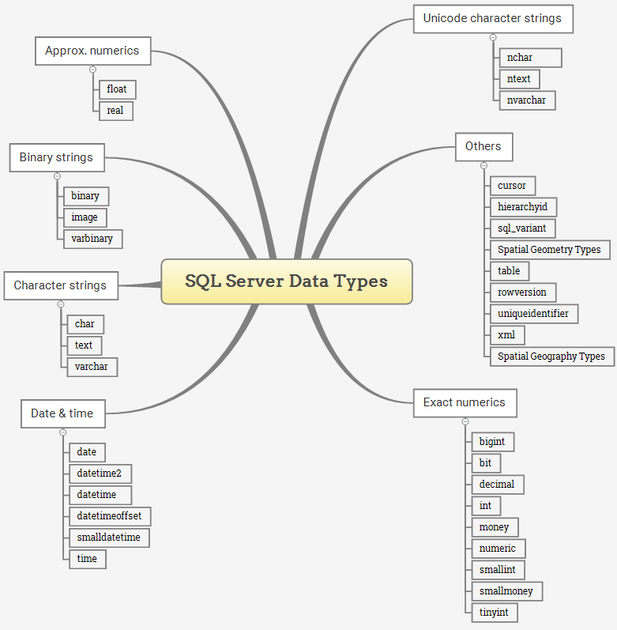
Data Types

Slide 5
Exact numeric data types
Exact numeric data types store exact numbers such as integer, decimal, or monetary amount.
The bit store one of three values 0, 1, and NULL
The int, bigint, smallint, and tinyint data types store integer data.
The decimal and numeric data types store numbers that have fixed precision and scale. Note that decimal and numeric are synonyms.
The money and small money data type store currency values.
Data Type | Lower limit | Upper limit | Memory
bigint | −2^63 (−9,223,372, 036,854,775,808) | 2^63−1 (−9,223,372, 036,854,775,807) | 8 bytes
int | −2^31 (−2,147, 483,648) | 2^31−1 (−2,147, 483,647) | 4 bytes
smallint | −2^15 (−32,767) | 2^15 (−32,768) | 2 bytes
tinyint | 0 | 255 | 1 byte
bit | 0 | 1 | 1 byte/8bit column
decimal | −10^38+1 | 10^381−1 | 5 to 17 bytes
numeric | −10^38+1 | 10^381−1 | 5 to 17 bytes
money | −922,337, 203, 685,477.5808 | +922,337, 203, 685,477.5807 | 8 bytes
smallmoney | −214,478.3648 | +214,478.3647 | 4 bytes

Slide 6
Approximate numeric data types
Data Type | Lower limit | Upper limit | Memory | Precision
float(n) | −1.79E+308 | 1.79E+308 | Depends on the value of n | 7 Digit
real | −3.40E+38 | 3.40E+38 | 4 bytes | 15 Digit
Data Type | Storage size | Accuracy | Lower Range | Upper Range
datetime | 8 bytes | Rounded to increments of .000, .003, .007 | 1753-01-01 | 9999-12-31
smalldatetime | 4 bytes, fixed | 1 minute | 1900-01-01 | 2079-06-06
date | 3 bytes, fixed | 1 day | 0001-01-01 | 9999-12-31
time | 5 bytes | 100 nanoseconds | 00:00:00.0000000 | 23:59:59.9999999
datetimeoffset | 10 bytes | 100 nanoseconds | 0001-01-01 | 9999-12-31
datetime2 | 6 bytes | 100 nanoseconds | 0001-01-01 | 9999-12-31
Date & Time data types

Slide 7
Character strings data types
Character strings data types allow you to store either fixed-length (char) or variable-length data (varchar). The text data type can store non-Unicode data in the code page of the server.
Data Type | Lower limit | Upper limit | Memory
char | 0 chars | 8000 chars | n bytes
varchar | 0 chars | 8000 chars | n bytes + 2 bytes
varchar (max) | 0 chars | 2^31 chars | n bytes + 2 bytes
text | 0 chars | 2,147,483,647 chars | n bytes + 4 bytes
Unicode character string data types
Unicode character string data types store either fixed-length (nchar) or variable-length (nvarchar) Unicode character data.
Data Type | Lower limit | Upper limit | Memory
nchar | 0 chars | 4000 chars | 2 times n bytes
nvarchar | 0 chars | 4000 chars | 2 times n bytes + 2 bytes
ntext | 0 chars | 1,073,741,823 char | 2 times the string length

Slide 8
Binary string data types
The binary data types stores fixed and variable length binary data.
Data Type Lower limit Upper limit Memory
binary 0 bytes 8000 bytes n bytes
varbinary 0 bytes 8000 bytes The actual length of data entered + 2 bytes
image 0 bytes 2,147,483,647 bytes

Slide 9
Other data types
Data Type | Description
cursor | for variables or stored procedure OUTPUT parameter that contains a reference to a cursor
rowversion | expose automatically generated, unique binary numbers within a database.
hierarchyid | represent a tree position in a tree hierarchy
uniqueidentifier | 16-byte GUID
sql_variant | store values of other data types
XML | store XML data in a column, or a variable of XML type
Spatial Geometry type | represent data in a flat coordinate system.
Spatial Geography type | store ellipsoidal (round-earth) data, such as GPS latitude and longitude coordinates.
table | store a result set temporarily for processing at a later time

Slide 10
SQL commands broadly fit into four categories:
DDL (Data Definition Language)
DML (Data Manipulation Language)
DCL (Data Control Language)
TCL (Transactional Control Language)
SQL DDL commands
The DDL commands in SQL are used to create database schema and to define the type and structure of the data that will be stored in a database. SQL DDL commands are further divided into the following major categories:
CREATE
ALTER
DROP
TRUNCATE

Slide 11
Foreign Key
In the relational databases, a foreign key is a field or a column that is used to establish a link between two tables.
In Simple words ,when data entry in one table is restricted to only those values which are present in another table . Data from primary key column from one table is entered into other table as a foreign key, So that there is a link between these two tables.

